Slide 1
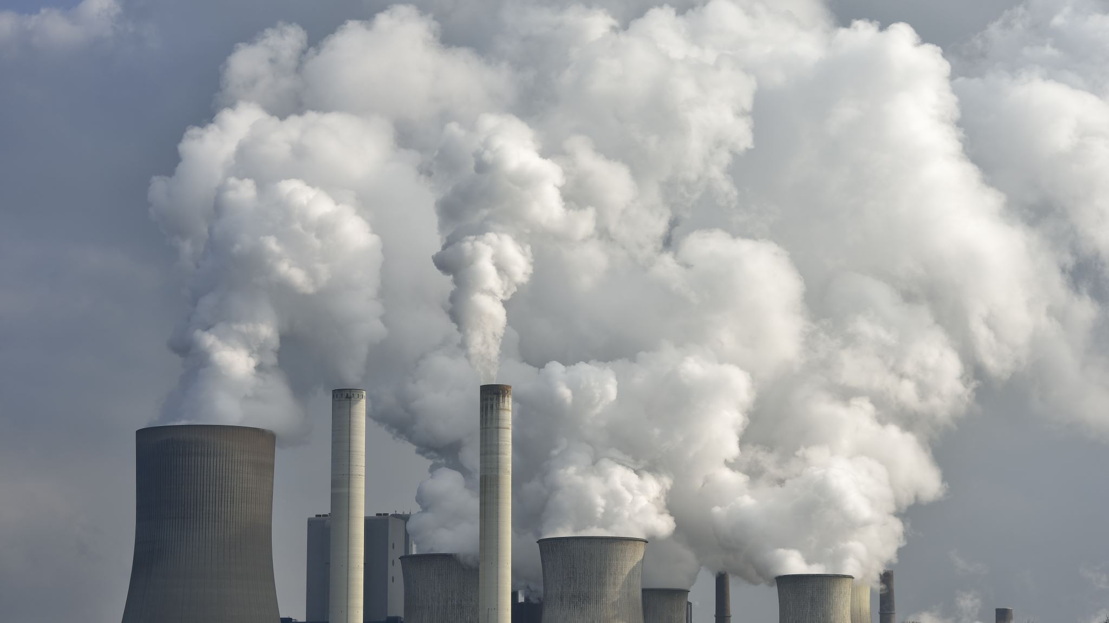
Are companies which disclose the most on carbon emission, ones who pollute the most ? Cephas Anna Nathanaëlle GATSE

Slide 2
https://ec.europa.eu/eurostat/statistics-explained/index.php?title=Quarterly_greenhouse_gas_emissions_in_the_EU#Emissions_by_economic_activity

Slide 3
What is the aim ?
The detection of greenwashing

Slide 4
Why ?
In many cases, the autors talk about the difficulties that had to measure / quantity the Co2 in the transportation field
Find an alternative way to detect greenwashing in transportation enterprises

Slide 5
Literature reviews
Sciencedirect «An international empirical study of greenwashing and voluntary carbon disclosure»
Sciencedirect « Is corporate social responsibility reporting a tool of signaling or greenwashing?»
« Exploring logistics-related environmental sustainability in large retailers»

Slide 6
Hypotheses development
Hypothesis :The companies which discloses the most on carbon emission pollute the most

Slide 7
We focus on:
-Transportation companies in European Union
-Listed transportation companies
Reformulation: «Are transportation european companies which disclose the most on carbon emission, one who pollute the most ?»

Slide 8
Disclose the most on carbon emission
→ number of environmental certification
→ number of SDG
→ If the company has CSR report or not
→ESG score
2) One who pollute the most
→ Variation of carbon emission between two years

